Slide 1


Data Analysis
SIT112 | Intro to Data Science & AI
Lecture Week 7
Dr. Fatima Ansarizadeh
Lecturer in Applied AI
School of Information Technology, Deakin University
Email: f.ansarizadeh@deakin.edu.au

Slide 2
Objectives
Melt the data in two or more columns.
Pivot the data in a DataFrame or create a pivot table from the data.
Bin the data for a column.
Select the rows with the n largest values from a DataFrame
Rank the rows in a DataFrame by largest or smallest values.

Slide 3

How to Create and Plot Long Data

Slide 4
Melting Data in Pandas
Melting reshapes a DataFrame from wide format to long format (more rows).
It takes several columns and stacks their names and values into rows.
Before melting: wide format
Each column is a category
Apply pd.melt()
Student | Subject | Score
Ali | Maths | 80
Sara | Maths | 90
Ali | Science | 75
Sara | Science | 85
Student | Maths | Science
Ali | 80 | 75
Sara | 90 | 85

Slide 5
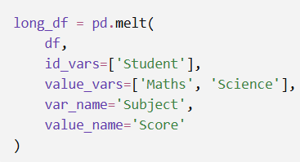
How pd.melt( ) works?
Student | Subject | Score
Ali | Maths | 80
Sara | Maths | 90
Ali | Science | 75
Sara | Science | 85
Student | Maths | Science
Ali | 80 | 75
Sara | 90 | 85
Long_df = pd.melt (df,...)
id, var, value
id_vars=['Student']
Keeps Student as an identifier. Its values are repeated when necessary.
var_name='Subject'
Names the new column containing the old column names
value_vars=['Maths', 'Science']
Specifies the columns that should be converted into rows.
value_name='Score'
Names the new column containing the original values
Notes:
Columns in neither argument are excluded:
A column that is not in id_vars or value_vars is excluded from the result.
Column location
What happens
In id_varsKept and repeated
In value_varsConverted into variable–value rows
In neither, when value_vars is providedExcluded
Not in id_vars, when value_vars is omittedAutomatically melted

Slide 6
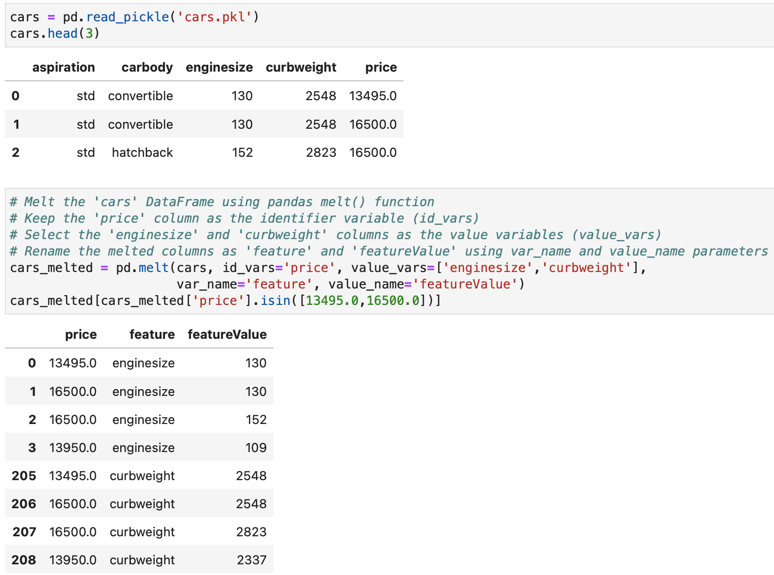
Melting Columns to Create
Long Data

Slide 7
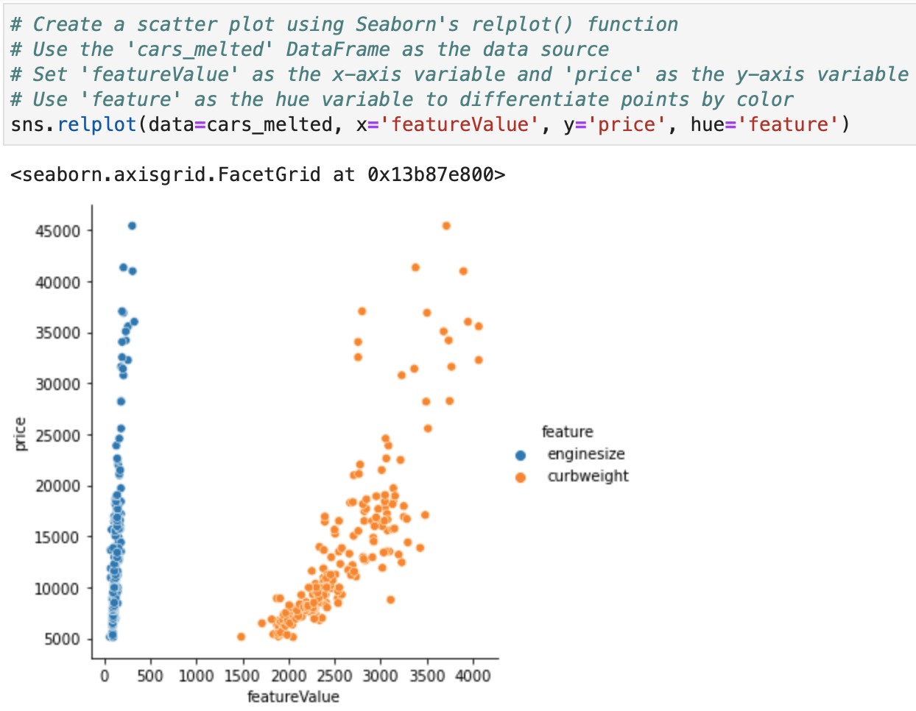
Plotting Melted Columns (Cont.)

Slide 8
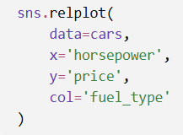
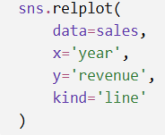
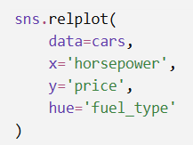
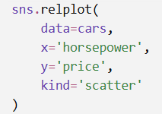
sns.relplot( )
It visualises relationships between variables.
It creates either scatter plots or line plots and can split the data into multiple subplots.
By default, relplot( ) creates a scatter plot.
Create separate subplots
Use colour for another variable
Create a line plot

Slide 9
Sns.relplot( ) parameters and their purposes
sns.relplot(x, y, kind, hue,…. )
Param | data | x | y | kind | hue | style | size | col | row | col_wrap | facet_kws
Purpose | DataFrame containing the data | Horizontal-axis variable | Vertical-axis variable | Creates a scatter or line plot | Represents a variable using colour | Uses marker shapes or line styles | Uses different point sizes | Creates subplots across columns | Creates subplots across rows | Wraps column facets onto multiple rows | Controls shared axes and other facet settings

Slide 10
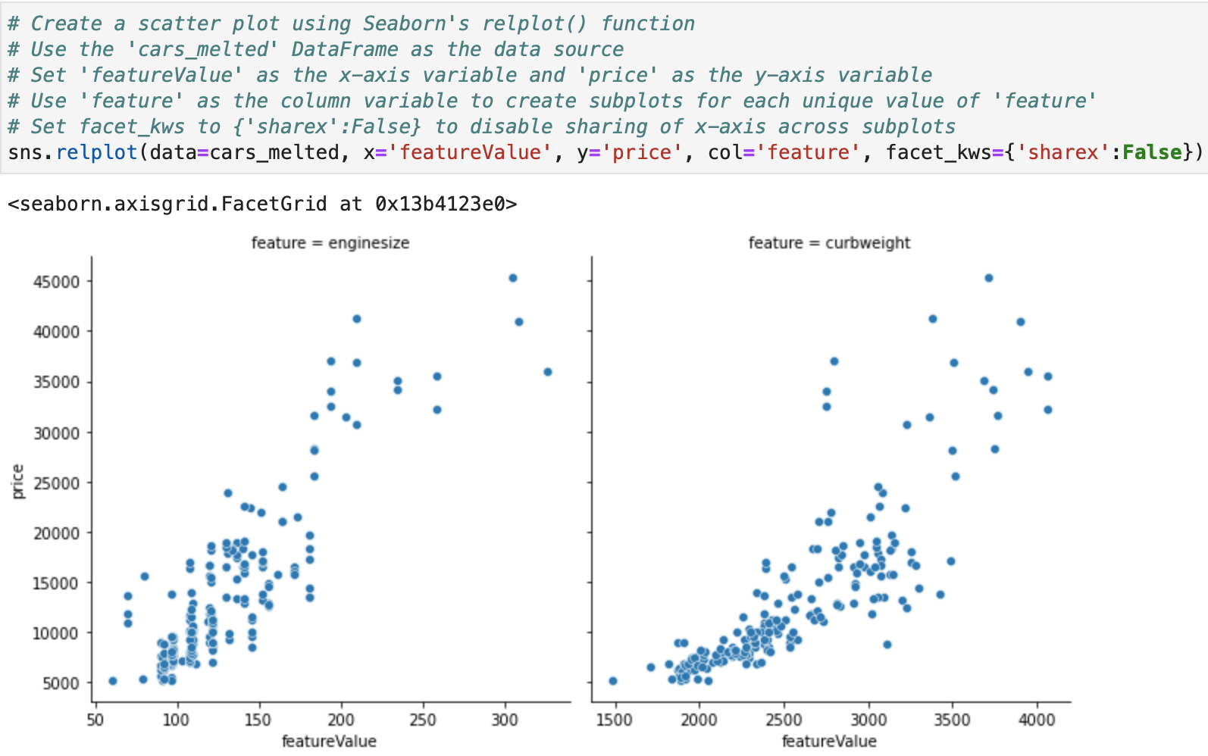
Plotting Melted Columns

Slide 11
How to Group and Aggregate the Data

Slide 12
How groupby() Orders Groups
By default, Pandas groupby() sorts group keys in ascending order because the default is:
df.groupby('column', sort=True)
Text values: alphabetical order
Numerical values: smallest to largest
Datetime values: earliest to latest

Slide 13
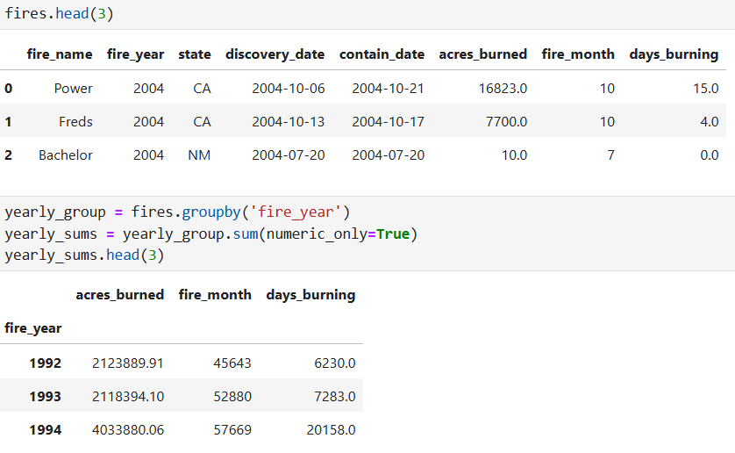
Working with a DataFrame GroupBy Object
Notes:
Categorical data and datetime datatypes ate ignored.

Slide 14
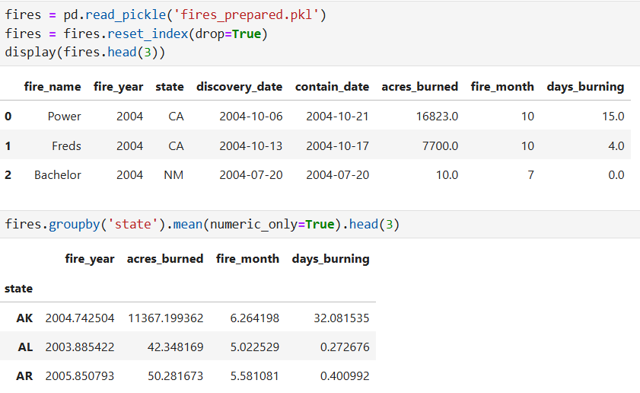
Group & Apply a Single Aggregate Method

Slide 15
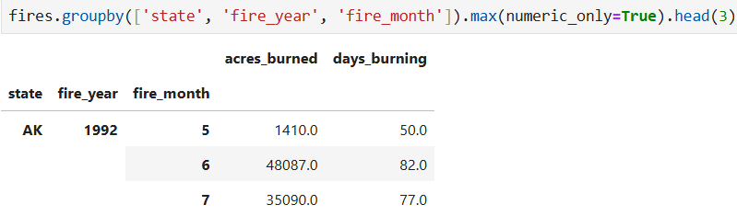
Group & Apply a Single Aggregate Method (Cont.)

Slide 16
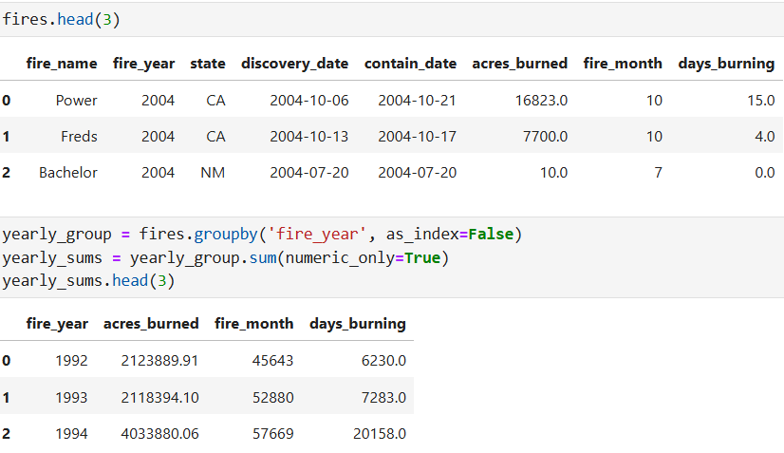
Group & Apply a Single Aggregate Method (Cont.)

Slide 17
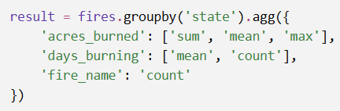
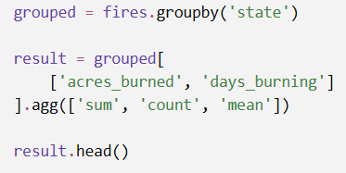
How to apply multiple aggregate methods
After grouping a DataFrame, use .agg() to apply several aggregation methods.
Different methods for different columns
Dictionary applies only the specified methods to each column.

Slide 18
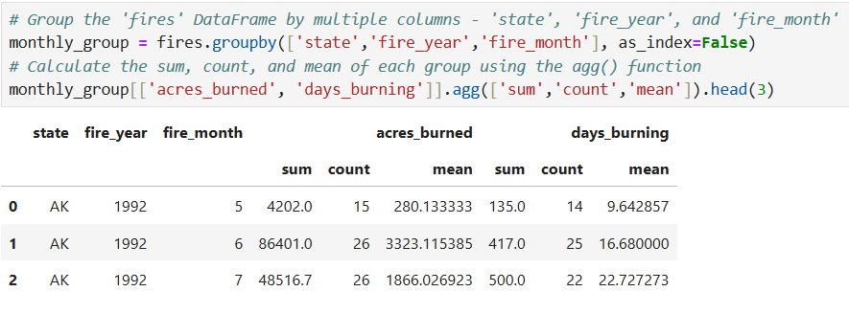
Group & Apply Multiple Aggregate Methods

Slide 19
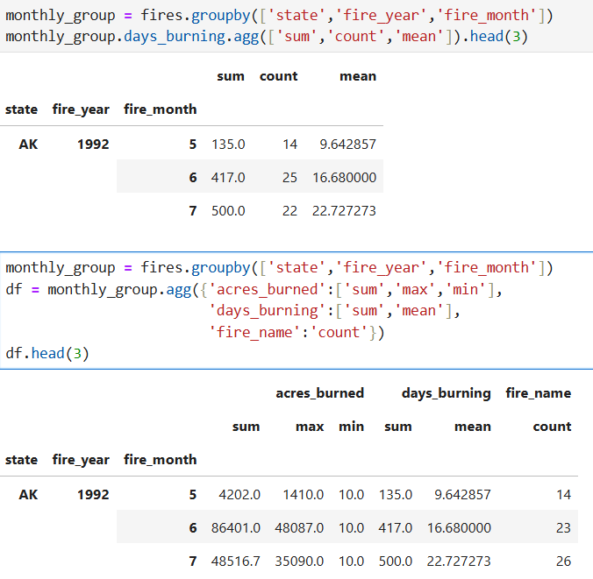
Group & Apply Multiple Aggregate Methods (Cont.)

Slide 20
How to Create and Use Pivot Tables

Slide 21
How to use the pivot( ) method
pivot() spreads the unique values from one column across new column headers.
So, it makes a long table into a wide table.
pivot() is used to reshape data from long format to wide format.
It reorganises your DataFrame without performing calculations.
pivot() doesn't calculate; it rearranges.

Slide 22
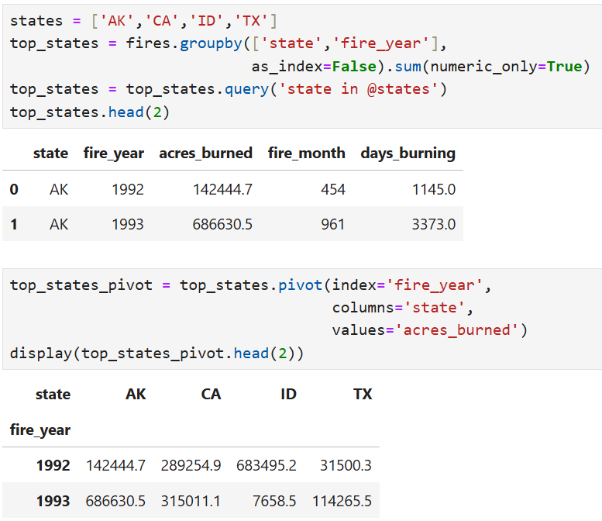
Using pivot()

Slide 23
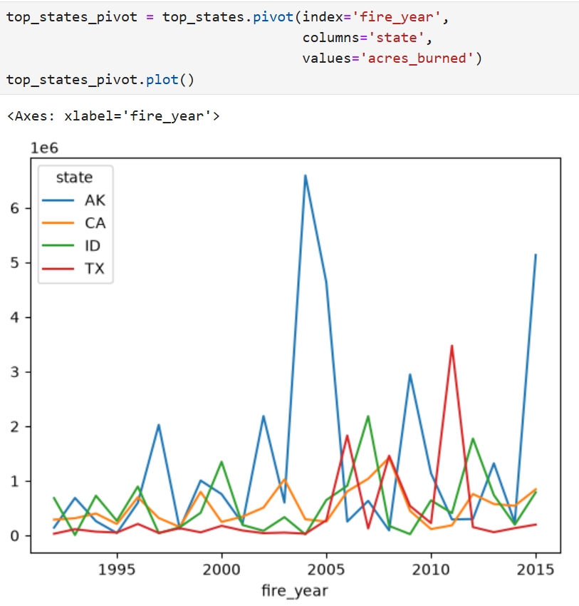
Using pivot() (Cont.)
Notes:
Messy1 getting an average may give a better understanding of the data

Slide 24

Pandas .pivot_table( )
.pivot_table( ) is used to summarise and reshape data at the same time.
The easiest way to remember it is:
pivot_table( ) = reshape + calculate
It uses (default is ‘mean’)
Unlike pivot( ), pivot_table( ) knows how to deal with multiple values for the same combination.

Slide 25
Takeaway
Use pivot() to reorganise data.
Use pivot_table() to reorganise AND summarise data.
Use pivot() when every combination has a unique value and you simply want to change the layout.
Use pivot_table() when you may have MULTIPLE values and need to summarise them.

Slide 26
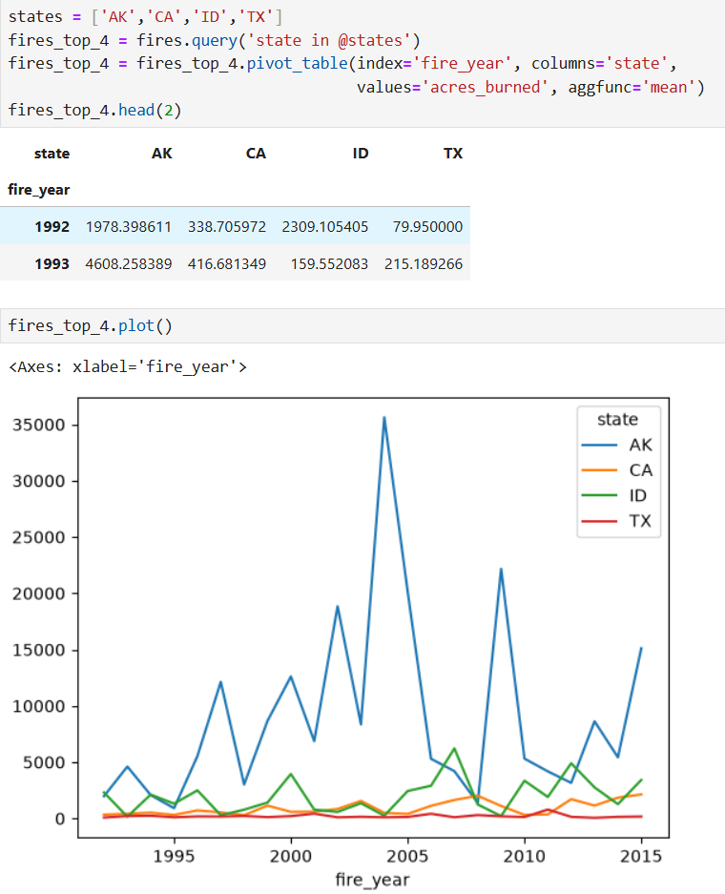
Using pivot_table()

Slide 27
How to Work with Bins

Slide 28
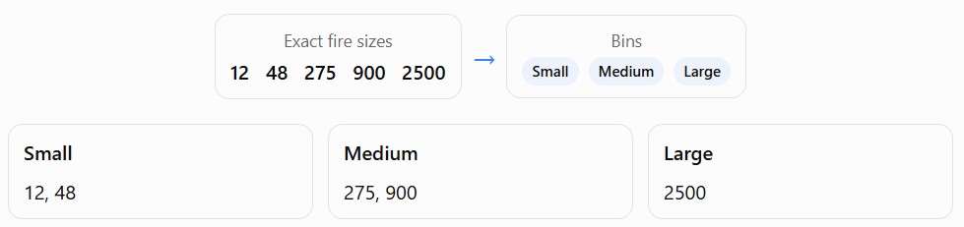
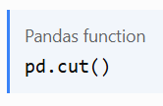
What is binning?
Binning converts continuous numerical values into meaningful categories or ranges.

Slide 29
Why do we bin data?
Easier to understand
Make continuous data easier to understand
Instead of interpreting every exact value:
Score = 82 → 🏅 Distinction
The number 82 is converted into a meaningful category, so the result is easier to interpret quickly.
Raw numerical data → Binning → Meaningful category
82 → pd.cut() → Distinction
Notes:
1. Make continuous data easier to understand
Exact numbers can be difficult to interpret quickly. Categories provide a simpler summary.
Score = 82 → Distinction
2. Compare groups
After binning, you can count or compare categories:
You could then answer:
How many fires were small?
3. Create clearer visualisations
Categorical ranges can be used in bar plots.
4. Reduce noise
Small numerical differences may not be important. For example, scores of 81 and 82 may both belong to the same grade category.

Slide 30
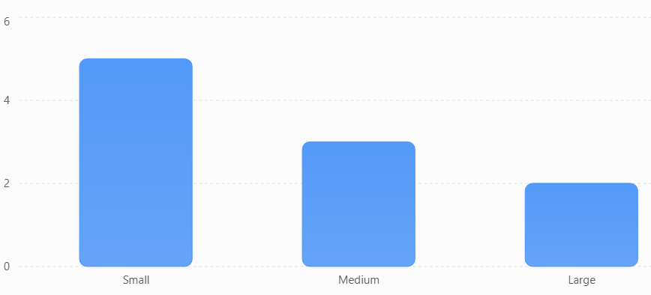
Make groups easier to compare
Suppose fire sizes are binned into Small, Medium, and Large. We can then count how many observations fall into each category:
After binning, questions such as “How many fires were small?” become easy to answer.
Continuous values → Categories → Count/compare groups → Easier insights

Slide 31
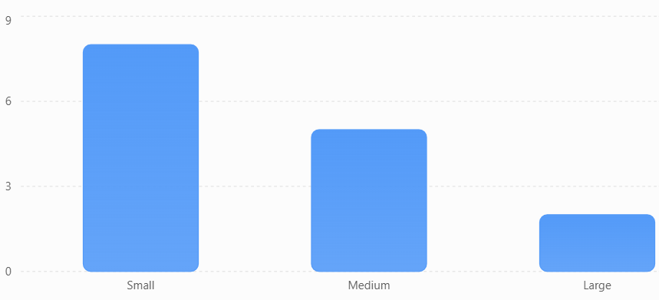
Create clearer visualisations
Once numerical values are converted into categories, we can create a simple bar plot and immediately see the distribution.
Fire sizes after binning:
Instead of looking at a long list such as 12, 48, 65, 130, 275, 420, 900..., you can quickly see the distribution across categories.

Slide 32
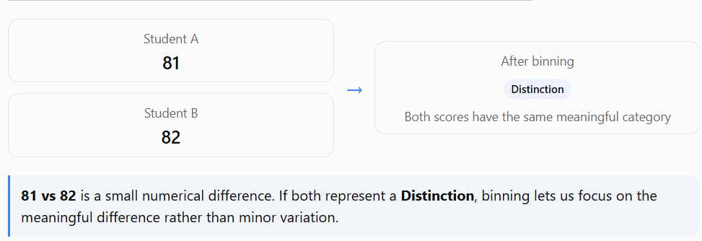
Reduce noise
Binning can also remove unnecessary differences between very similar values.
Sometimes a small numerical difference does not change the meaning of the data.
Notes:
81 ≠ 82 numerically, but 81 and 82 may mean the same thing categorically → Distinction.
That is what we mean when we say binning can reduce noise.

Slide 33
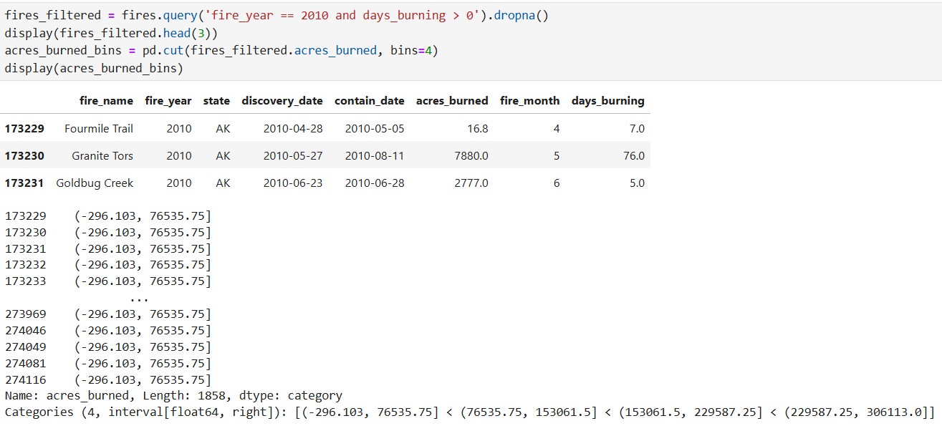
Creating Bins of Equal Size

Slide 34
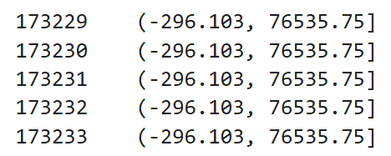
How to interpret bins?
The first number is the index label of the original row in fires_filtered. It is not the number of acres burned.
The second one is the bin interval assigned to that row:
-296.103 is the lower boundary.
76535.75 is the upper boundary.
( means the lower boundary is excluded.
] means the upper boundary is included.

Slide 35
Understanding interval boundaries
By default, `pd.cut()` creates intervals that are open on the left and closed on the right:
(0, 100]
This means:
greater than 0 and less than or equal to 100
So:
  100 belongs to the first bin.
  101 belongs to the second bin.

Slide 36
How Pandas allocate bins?
When bins=4, Pandas finds the minimum and maximum;
divides that range into four equal-width intervals;
slightly extends the boundary by approximately 0.1% of the range so the minimum value is included.
If your dataset contains a very large maximum fire size, even 0.1% of the range is large enough to push the first boundary below zero:
This interval means:
−296.103<acres burned≤76535.75
It does not mean that the selected fires have negative sizes
(-296.103, 76535.75]

Slide 37
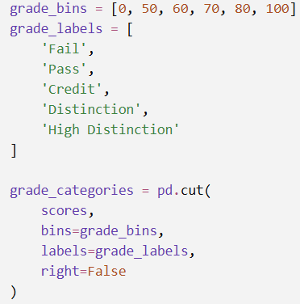


Custom Bins
Automatic Bins
Manually selected meaningful boundaries
These boundaries are mathematically equal, but values such as 54 and 76 do not necessarily correspond to meaningful academic grades.
Automatic bins divide the numerical range evenly;
Manual bins divide it according to meaningful real-world rules.
Notes:
This interval does not include 32. To ensure the minimum value is included, Pandas extends the lower boundary by 0.1% of the total range: 98-32=66
0.001×66=0.066 32−0.066=31.934
Therefore, the first interval becomes:
(31.934, 54.0]
31.934 is not a value in the data. It is an automatically adjusted boundary that ensures the minimum value 32 belongs to the first bin.

Slide 38
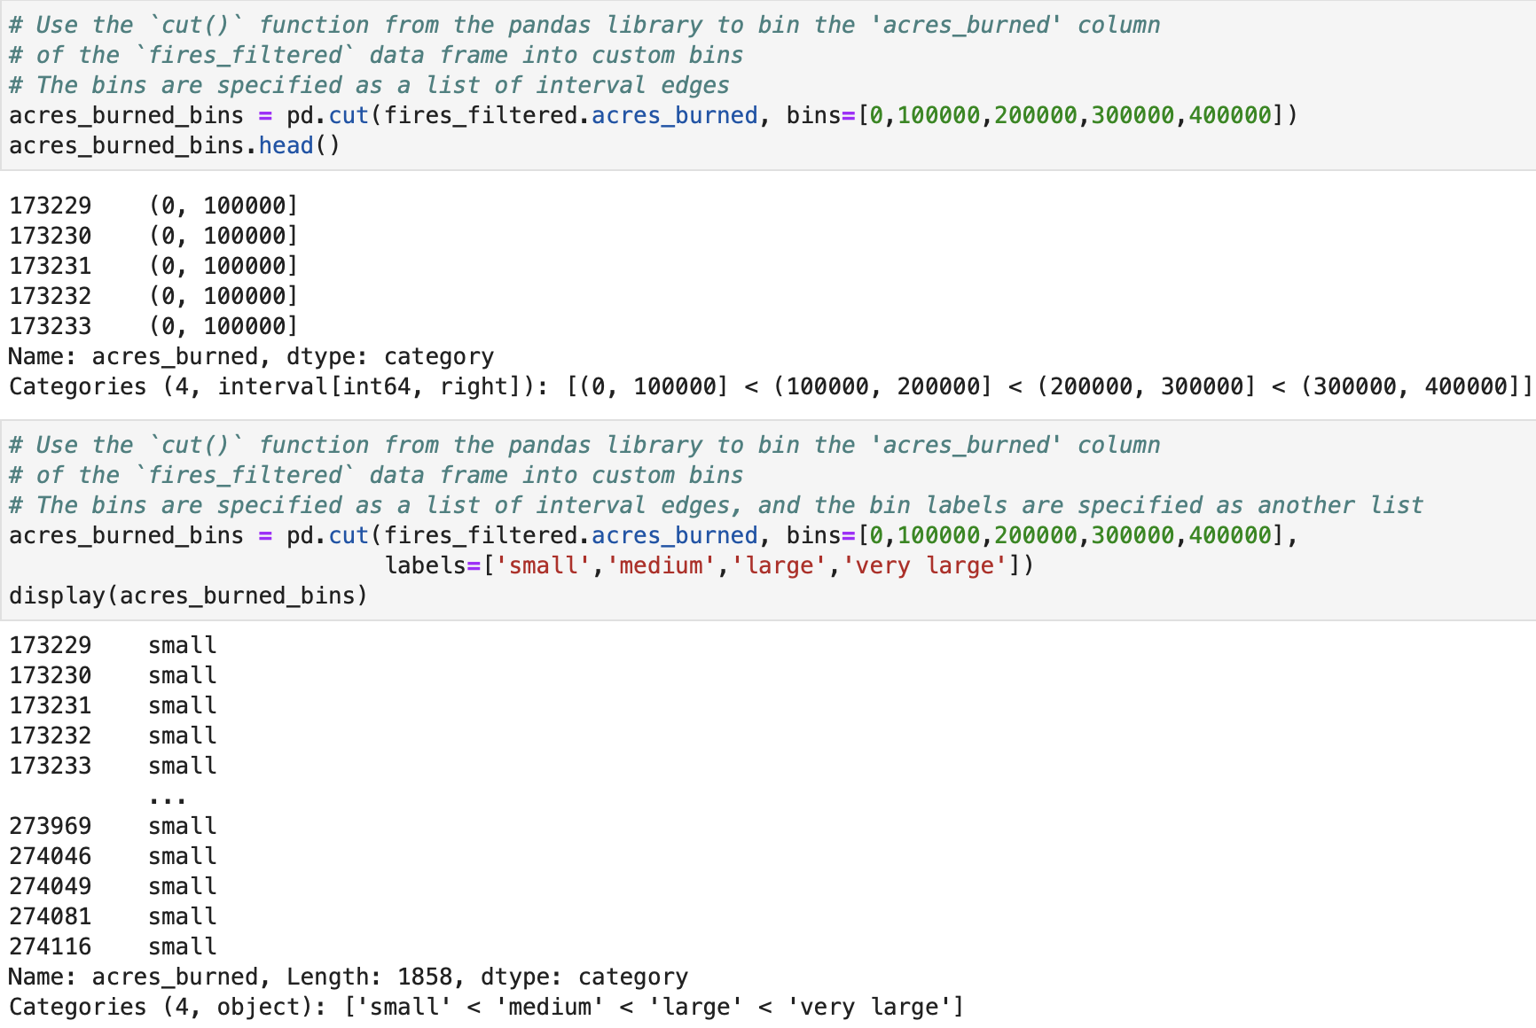
Creating Custom Bins
(Cont.)

Slide 39
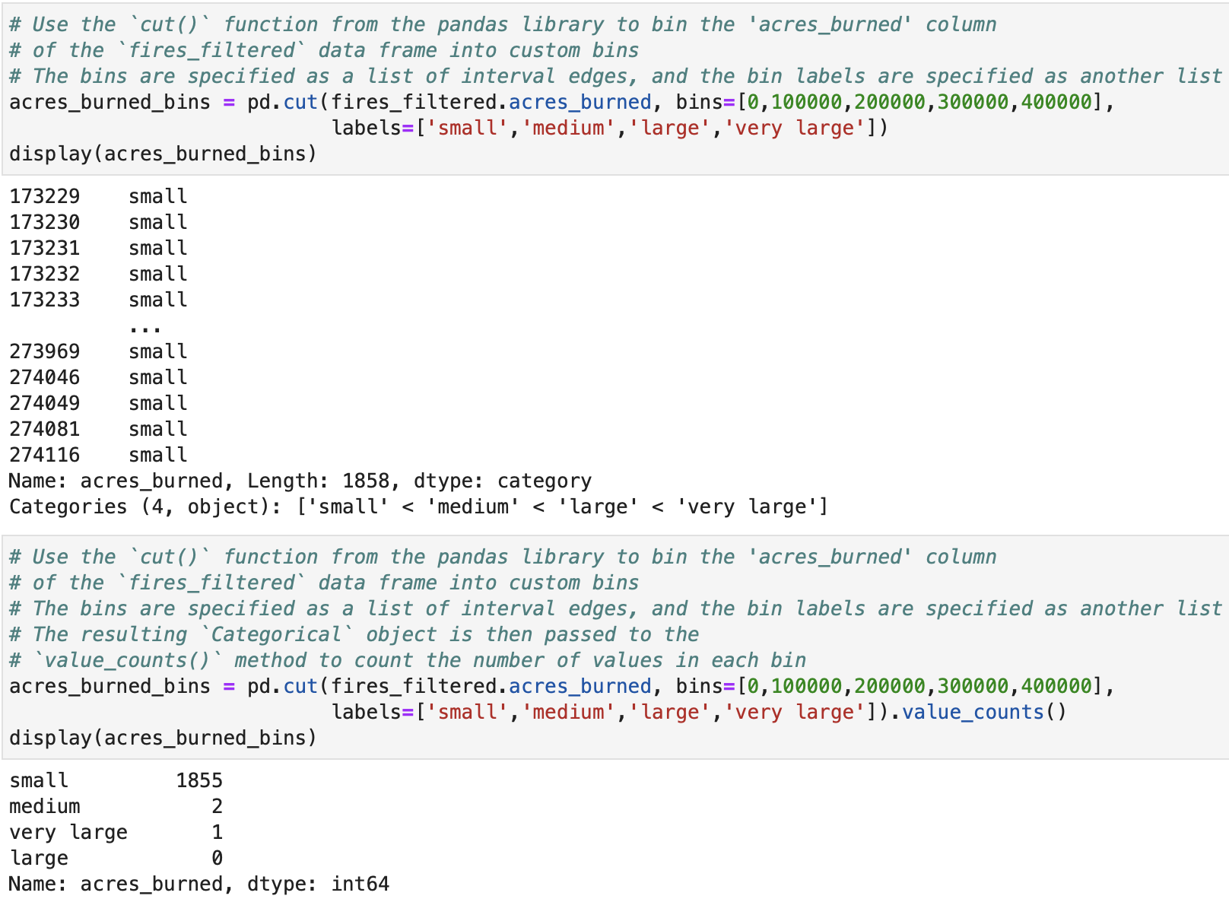
Creating Custom Bins
(Cont.)

Slide 40
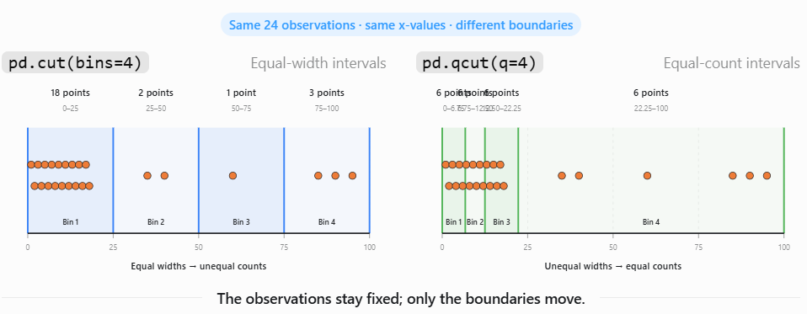
pd.qcut( )
pd.cut(bins=4) creates equal-width ranges;
If data is highly skewed, equal-width bins may place most observations in one bin.
pd.qcut(q=4) creates bins containing approximately equal numbers of observations.

Slide 41
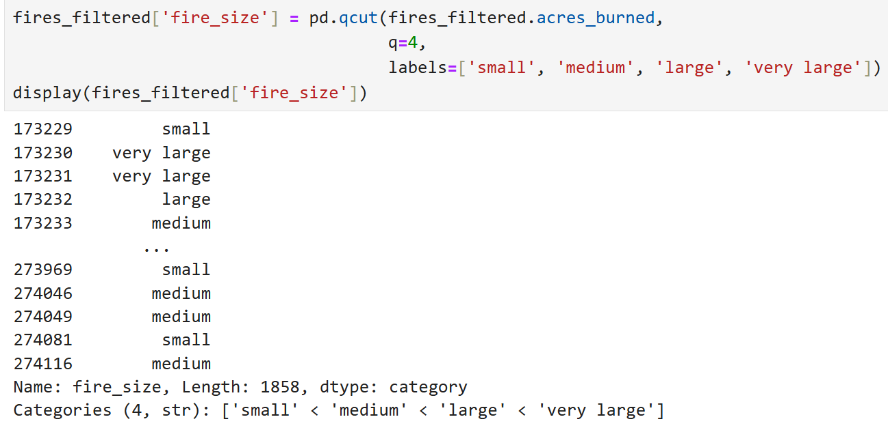
Creating Bins with Equally Distributed Data Points

Slide 42
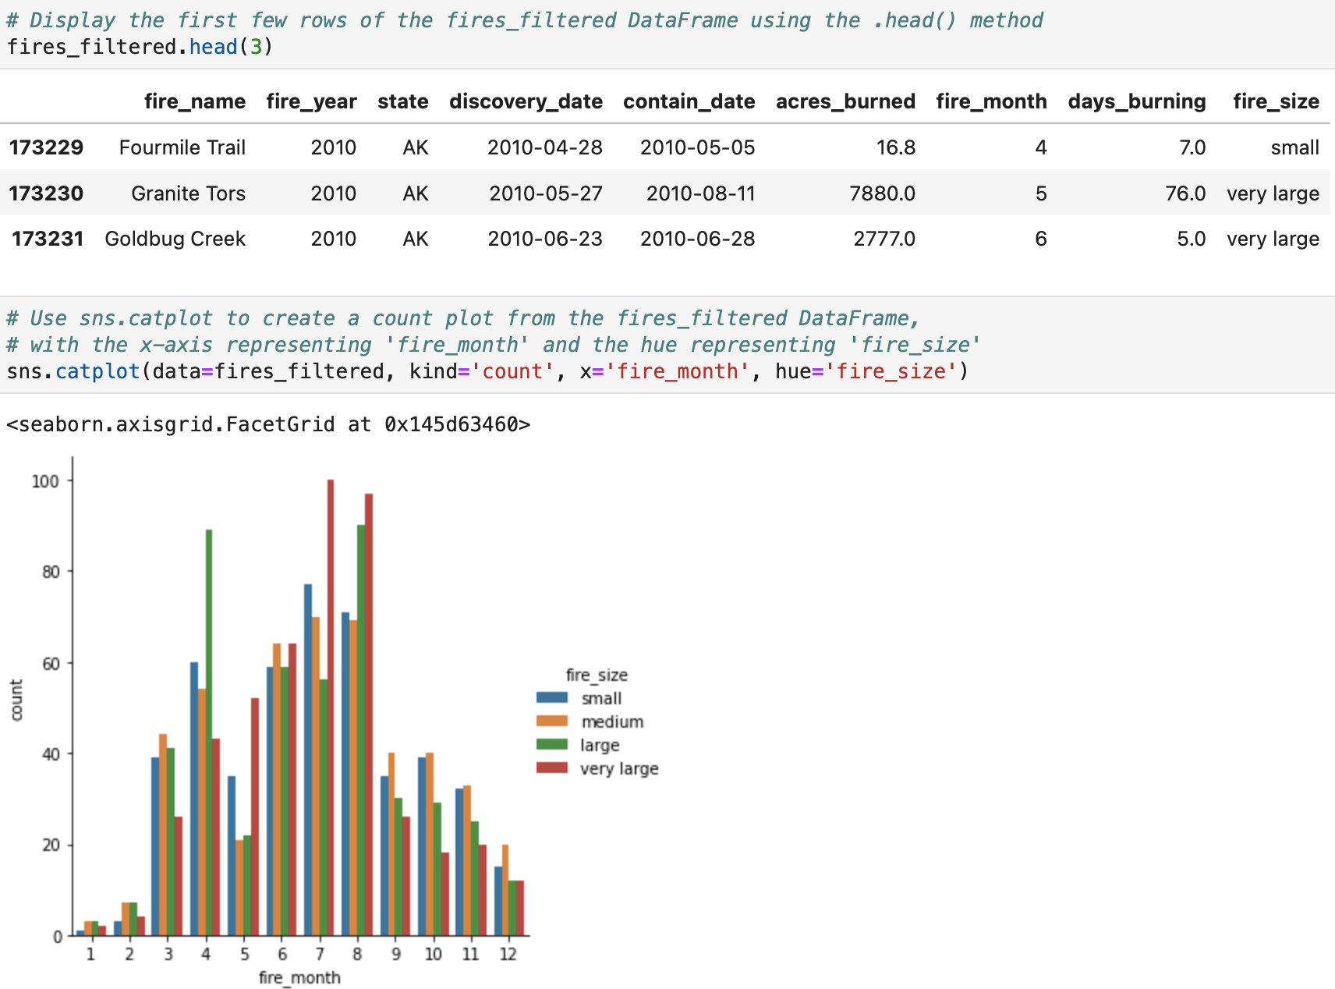
Plotting the Binned Data

Slide 43
sns.catplot()
sns.catplot() is a Seaborn function for visualising relationships involving at least one categorical variable.
catplot() is a figure-level function, making it easier to create multiple subplots using col and row.
Notes:
Both are figure-level Seaborn functions, but they are designed for different relationships:
sns.catplot() compares values across categories.
sns.relplot() shows relationships between numerical variables.

Slide 44
More Skills for Data Analysis

Slide 45
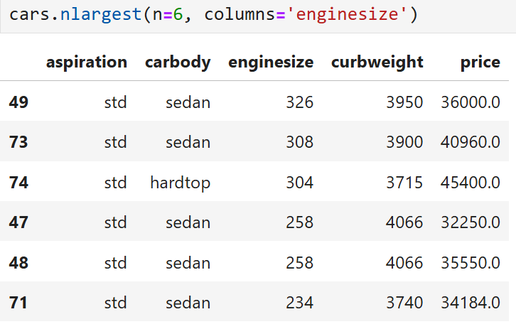
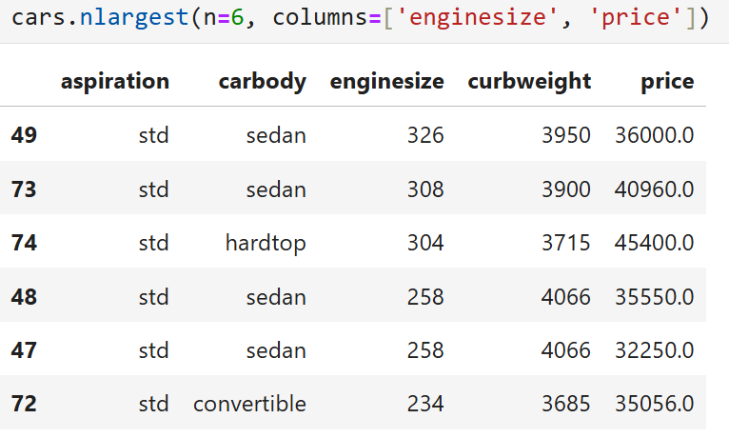
Get the
Top N Rows

Slide 46

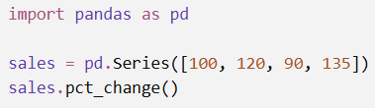
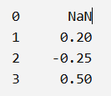
df.pct_change( )
It calculates the percentage change between a value and its previous value in a Pandas Series or DataFrame.
The first result is NaN because there is no earlier value to compare with.
From 100 to 120: (120 − 100) / 100 = 0.20 → 20% increase
From 120 to 90: (90 − 120) / 120 = −0.25 → 25% decrease
From 90 to 135: (135 − 90) / 90 = 0.50 → 50% increase

Slide 47
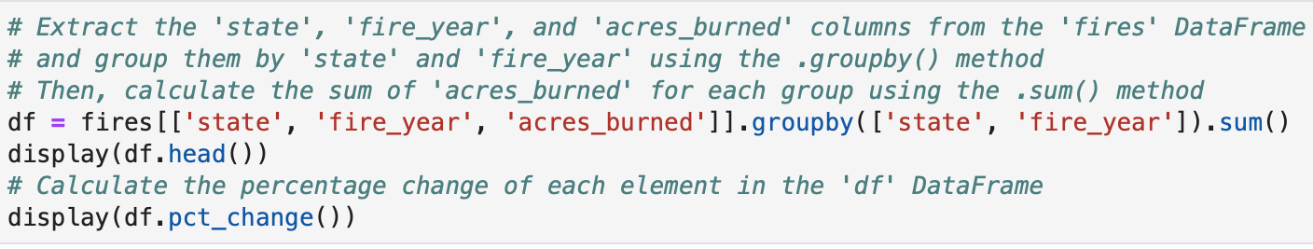
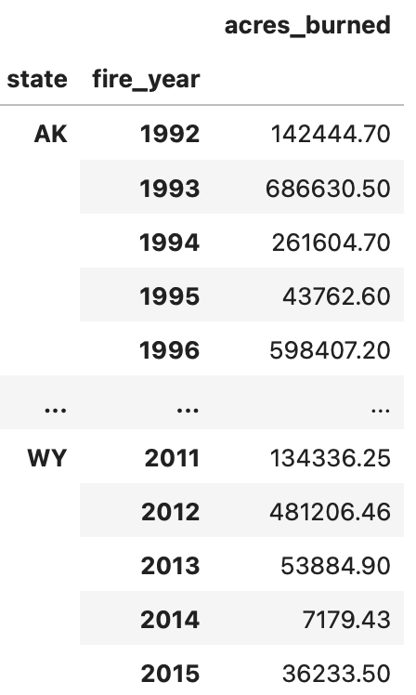
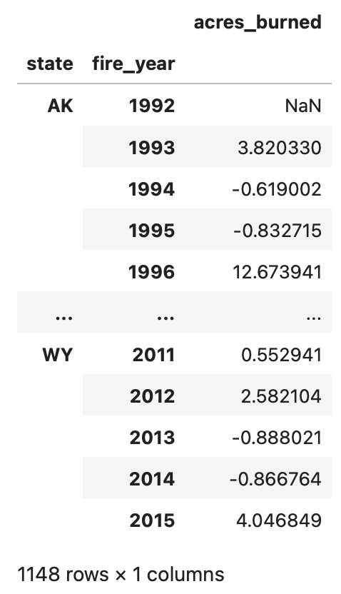
Calculate Percent Change

Slide 48
df.column.rank( )
.rank() assigns a rank or position to each value in a Pandas Series or DataFrame.
By default, the smallest value receives rank 1.
To give the largest value rank 1, use: df.column.rank(ascending=False)

Slide 49
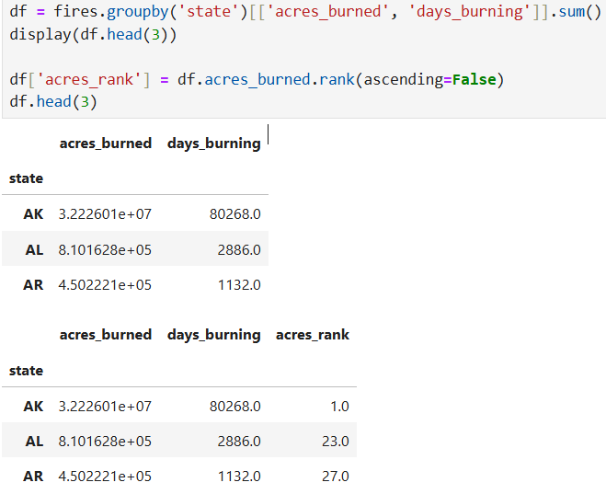
Ranking Rows

Slide 50


What happens when values are equal?
The method parameter in the rank() method specifies how to handle ties, i.e., situations where two or more elements have the same value.
Original score | Rank
90 | 4.0
80 | 2.5
80 | 2.5
60 | 1.0
The two 80 values are tied. They occupy positions 2 and 3, so the default method='average' gives both:

Slide 51
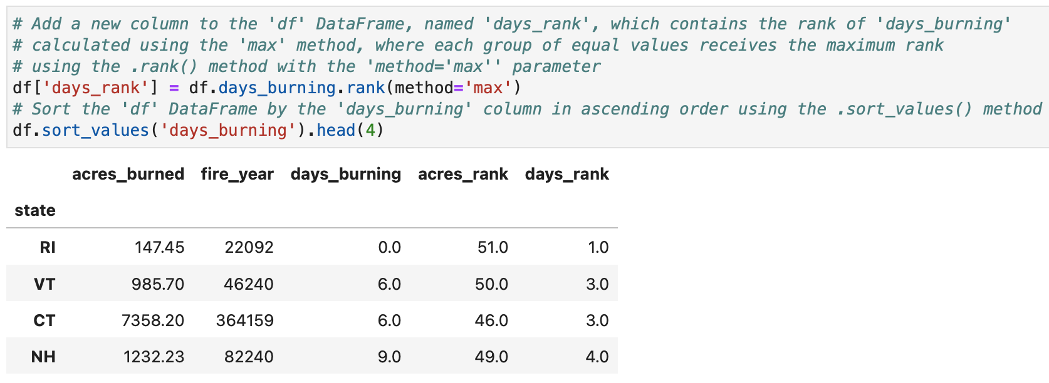
Ranking Rows
In this case, method='max' means that the largest rank is assigned to the tied values. If two elements have the same value, they are both assigned the highest rank.

Slide 52
References
Data science from scratch: first principles with Python, Joel Grus, O'Reilly Media, 2019
Python for Data Analysis: Data Wrangling with Pandas, NumPy, and IPython, Wes McKinney, O'Reilly Media, 3rd edition, 2022.
Python Data Science Handbook: Essential Tools for Working with Data, Jake Vanderplas, O'Reilly Media, 2022
Murach’s Python for Data Analysis, Scott McCoy, Mike Murach & Associates, Incorporated, 2021.
Intro to Python for Computer Science and Data Science: Learning to Program with AI, Big Data and The Cloud, Paul Deitel, Pearson Education Limited, 2021.
ChatGPT

Slide 53

End of lecture …
End of lecture …

